Slide 1
This information is designed to provide accurate and authoritative information with regard to the subject matter covered. It is offered with the understanding that the presenters are not engaged in rendering legal, accounting, or other professional services. If legal advice or other expert advice is required, the services of a competent professional should be sought.

Slide 2
The Ultimate Guide to CapEx for Rental Property
James Orr
jamesorr@gmail.com
https://RealEstateFinancialPlanner.com

Slide 3
Introductions via Chat
Pro Tip: Make sure you send to “All panelists and attendees”
Who are you and where are you from?
What’s your best CapEx tip?
Got questions? If you have questions for the webinar, use the chat interface.

Slide 4

Why You Should Not Consider Anything I Say As Advice or Even Reliable Information or Education
I’m not your Realtor, Attorney, Accountant/CPA, Advisor
Facts do vary – greatly
Chances are I don’t know what I’m talking about
I don’t always get good sleep and may be fuzzy-brained
I’m easily confused… maybe you are too

Slide 5
The Ultimate Guide to CapEx for Rental Property
James Orr
jamesorr@gmail.com
https://RealEstateFinancialPlanner.com

Slide 6
CapEx versus Maintenance
Talk to your CPA
  See Internal Revenue Code (IRC) Section 162
Safe Harbor allows you to write off expenses under $2,500 in the year you take it
  Per invoice or item
  Up from $500 prior to Jan 1, 2016
  Do NOT need to capitalize the expense over time
Those with audited financial statements it is $5,000

Slide 7
Rental Property as IRS “Qualified Business”
Separate books and records are maintained to reflect income and expenses for each rental real estate enterprise;
For taxable years beginning prior to January 1, 2023, 250 or more hours of rental services are performed (as described in this revenue procedure) per year with respect to the rental enterprise. For taxable years beginning after December 31, 2022, in any three of the five consecutive taxable years that end with the taxable year (or in each year for an enterprise held for less than five years), 250 or more hours of rental services are performed (as described in this revenue procedure) per year with respect to the rental real estate enterprise; and
The taxpayer maintains contemporaneous records, including time reports, logs, or similar documents, regarding the following: (i) hours of all services performed; (ii) description of all services performed; (iii) dates on which such services were performed; and (iv) who performed the services. Such 8 records are to be made available for inspection at the request of the IRS. The contemporaneous records requirement will not apply to taxable years beginning prior to January 1, 2019.

Slide 8
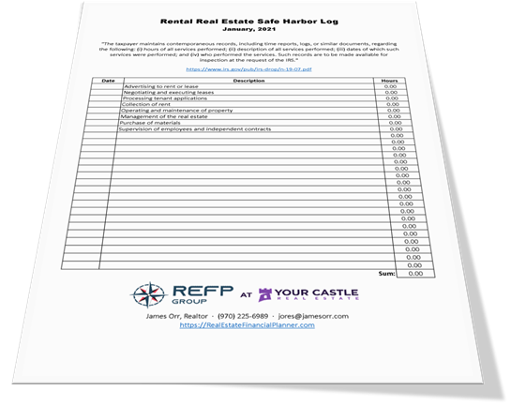
Real Estate Investor QBI Log
To qualify for safe harbor, you must keep contemporaneous logs
Any log will do, but if you want to download our simple Rental Property Safe Harbor Log template, go to:
https://refp.com/log

Slide 9
Traditional Maintenance vs Capital Expenses
Maintenance
Capital Expenses
Small turnover expenses
  Wear and tear that can’t be billed back to tenant
Repairs to items that break
  Service calls to plumbers, roofer, HVAC techs, electricians, handymen, landscapers and related supplies
Replace Roof and/or Gutters
Replace AC and/or Furnace/Boiler
Kitchen/Bathroom Remodels
Replace Windows
Replace Driveway
Replace Appliances
Replace Water Heater
Exterior Paint

Slide 10
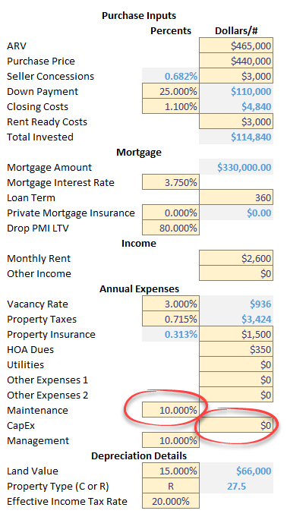
Separate Maintenance and CapEx?
You could and The World’s Greatest Real Estate Deal Analysis Spreadsheet™ and the Real Estate Financial Planner™ properties have two separate fields for those that do
  https://refp.com/spreadsheet
Or… you could choose to think of them together for deal analysis and everything except taxes (where you capitalize improvements over $2,500)
Maintenance is PERCENT of Gross Operating Income
CapEx is in DOLLARS
  With its own CapEx Appreciation Rate (in Override tab)

Slide 11
Paint and Carpet/Flooring
Is repainting (the interior) and replacing carpet/flooring maintenance or capital expense?
Some real estate investors will include paint and carpet/flooring as a “maintenance expense” (at least when analyzing their deal)
IMPORTANT NOTE: including paint and carpet as a maintenance expense can result in you having an abnormally large maintenance percentage

Slide 12
Impact of Price/Rent on Maintenance %
Let’s assume:
  Tenant-turnover every 2-3 years (let’s use 2.5 years)
  Replace paint/carpet/flooring every 2 turns (5 years)
    Could be every tenant-turnover or could 3 or 4 turns
  You go to a big box store and price out the most basic, least expensive:
    Paint: $2/sq ft
    Carpet/Flooring: $3/sq ft
For a 1,600 sq foot 3 bedroom property, the expense for paint and carpet every 5 years is:
  Paint: $2/sq ft * 1,600 sq ft = $3,200
  Carpet/Flooring: $3/sq ft * 1,600 sq ft = $4,800
  Total every 5 years: $8,000 or $1,600 per year
And, since this is the most basic and LEAST expensive that’s $1,600 per year whether you’re owning a $100,000 property getting $1,000 per month or a $500,000 property getting $2,500 per month

Slide 13
Impact of Price/Rent on Maintenance %
$100K Rental Getting $1,000/mo
$500K Rental Getting $2,500/mo
Gross Operating Income = $12,000 – 3% Vacancy = $11,640
$1,600 per year just for basic, least expensive paint and carpet/flooring
$1,600/$11,640 = 13.75% Maintenance
  Just for paint/flooring every 2 turns
  Does not include any other maintenance
Gross Operating Income = $30,000 – 3% Vacancy = $29,100
$1,600 per year just for basic, least expensive paint and carpet/flooring
$1,600/$29,100 = 5.50% Maintenance
  Just for paint/flooring every 2 turns
  Does not include any other maintenance

Slide 14
Not Just Paint and Carpet/Flooring…
There may be some regional differences in prices/wages, but for similar-sized properties, often the price for the following are not significantly different
  Roofs
  Water Heaters
  Windows
  Hourly Wages for Trades
    Plumber, HVAC Tech, Electrician, Handyman
Such that buying a low-priced (for example $100K) property will often have a VERY high percentage of Gross Operating Income for maintenance and CapEx compared to a similar square footage property in a more expensive market (for example $500K properties)
That’s why…

Slide 15
You Must Do Your Own Due Diligence
You should research how much it might cost YOU to replace a roof in your market and how long that roof will last for
IMPORTANT NOTE: Longevity also changes based on location!
These numbers are very ROUGH estimates, but you can’t just use them as-is
You may be able to get discounts, do some things yourself (see Asset Protection classes)

Slide 16
Maintenance and Capital Expenses
You have 3 options:
  Ignore Them – Head in the sand, ignorance is bliss, deal analysis becomes fantasy-land
  Basic Planning – Estimate costs and determine an average amount you need to save each year. This is essentially our Basic spreadsheet.
  Advanced Planning – Cash flow planning for your expenses. Know what your upcoming expenses are, when they’ll happen, and budget for them. This is our Advanced spreadsheet.
    Like your parenting expenses: kid’s braces, sport camps, music lessons, car for kids, college entrance exam tutoring, college costs (tuition, room, board), help with first down payment, wedding, help after divorce/job loss, etc… you need to be setting aside money for these things like your property maintenance and capital expenses.

Slide 18
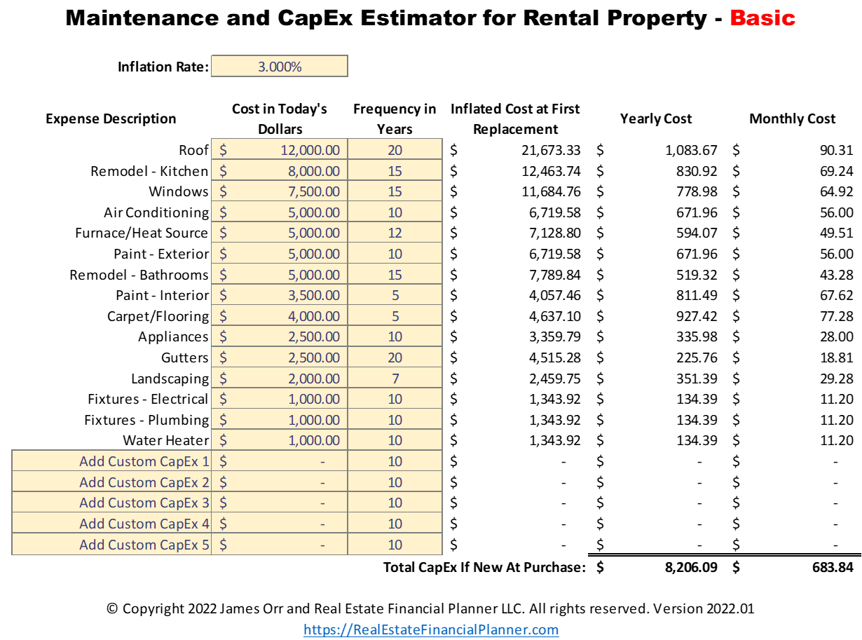
“Basic” Instructions
Research and enter:
  The Cost in Today’s Dollars for each expense
  The lifespan or Frequency in Years for replacing that item
Include any custom expenses in spaces provided
  “Add Custom CapEx #”
Enter in your Inflation Rate
Use the Yearly Cost or Monthly Cost in your analysis and spreadsheet under CapEx
Use your Inflation Rate for the CapEx Appreciation Rate

Slide 19
Demo

Slide 20
Shortcomings of BASIC Version
What if you’re buying a property where everything is not new and at the beginning of their life cycle? Like a resale property that has some deferred or upcoming maintenance?
What if certain items will increase in price faster than others (different inflation on different items)?
What if you’re starting with some money set aside for known repairs?
What if you’re earning a return on money you have set aside for expenses?
What if you’re going to increase how much you’re saving each year as rents go up?
That’s why I created the ADVANCED version!

Slide 22
Overrides for Each Expense

Slide 23
Override Instructions
Change for any expense individually for each year:
  Inflation Rate
  Cost
  Current age
  Lifespan (aka replacement frequency)
  When you had the expense
  How much you spent on that expense

Slide 24
Override for Expense Account
Change for any year:
  How much to increase the amount you’re saving each year
  The amount you’re saving
  The yearly rate of return for the account you’re storing your expense money
  The balance in any given year
  Or, the deficit in any given year
See the most expensive year and largest deficit

Slide 25
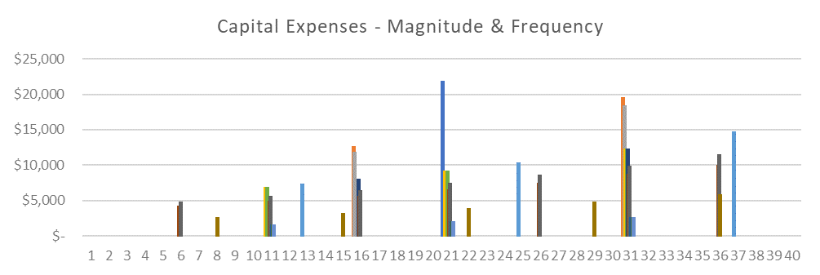
See each expense, how much it is and when it happens at-a-glance.
This is NOT an exact science!

Slide 26
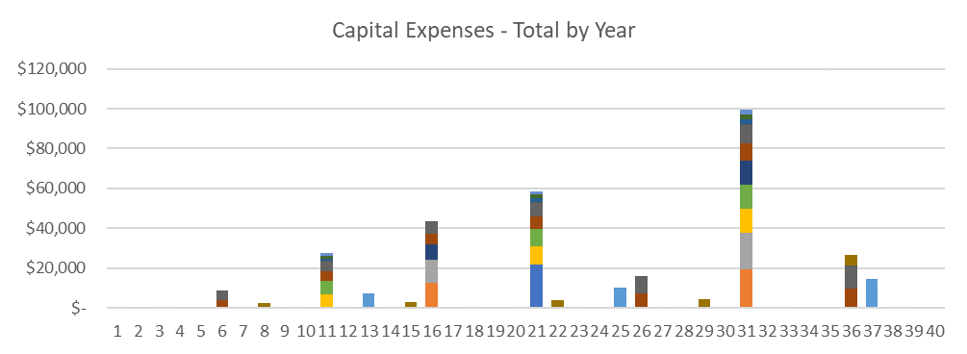
See the total of all expenses by year and their relative sizes.

Slide 27
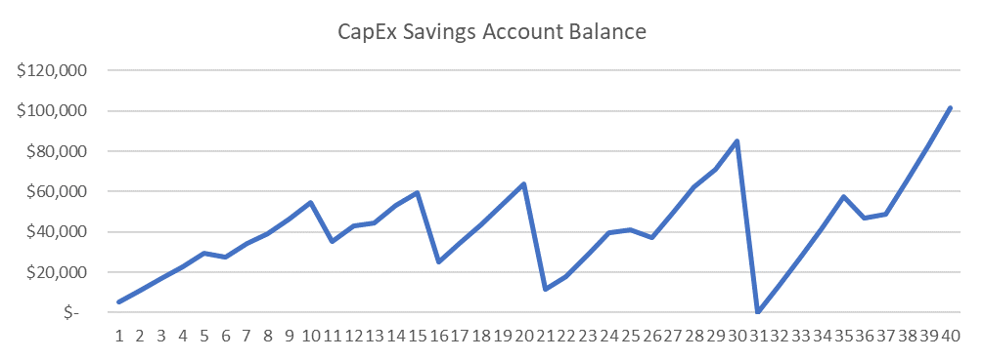
Expense Cash Flow Planning Tool
See how much you’ve saved for your expenses and when
See when your expense savings account is at its lowest

Slide 28
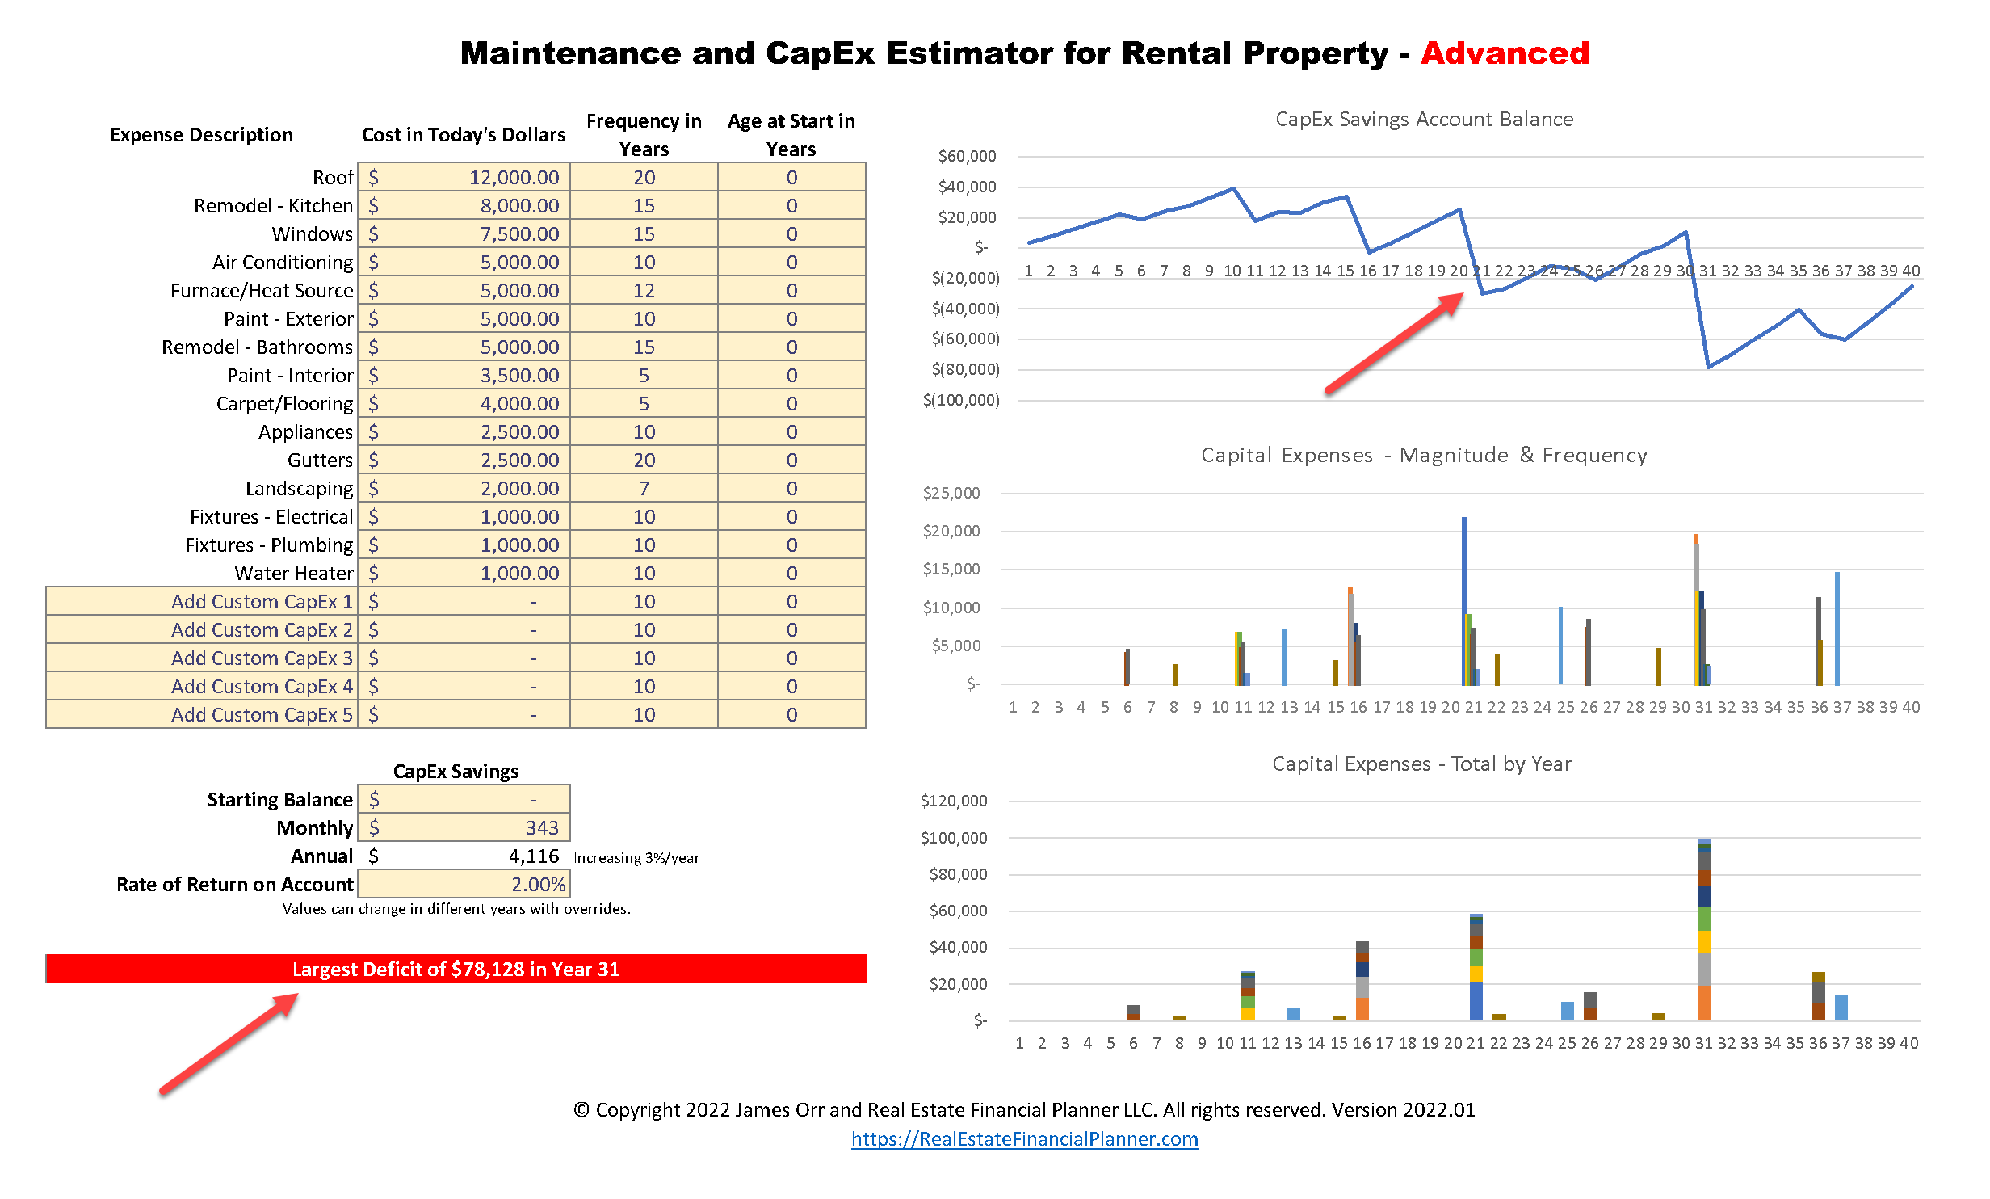
Identify Deficits

Slide 29
“Advanced” Instructions
Research and enter:
  The cost in today’s dollars for each expense
  The lifespan or frequency of replacing that item (in years)
  Age at Start in Years
Include any custom expenses in spaces provided
Enter in a combination of your Starting Balance, Monthly amount saved and Rate of Return on Account
  Adjust these numbers until you have “No Deficit” (green bar)
Use Overrides if desired
Use the following in your analysis and spreadsheet:
  Annual (or Monthly * 12) in the annual CapEx input
  Starting Balance in Rent Ready Costs

Slide 30
Demo

Slide 31
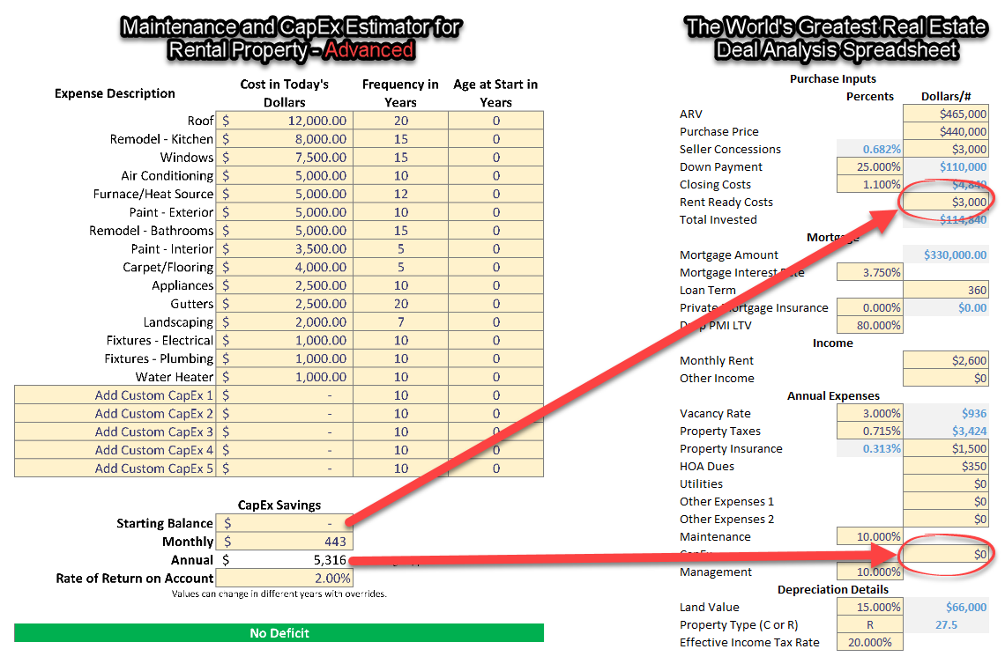
Where To Enter Them on TWGREDAS

Slide 32
Why A Starting Balance?
What if you bought a resale property that you KNEW needed a new roof in the next 2 years?
You might find it difficult to “save” enough with cash flow in 2 years to fund a new roof purchase.
Instead, you could set aside money (as Rent Ready Costs) to initially seed your expense account.
Then, use the Maintenance and CapEx Estimator for Rental Property – Advanced spreadsheet to see how much you’d need to save monthly to avoid having a deficit
Repeat this for any known upcoming or deferred maintenance
Your expense account is a combination of the amount you start with and the amount you save each month minus the expenses you have coming up

Slide 33
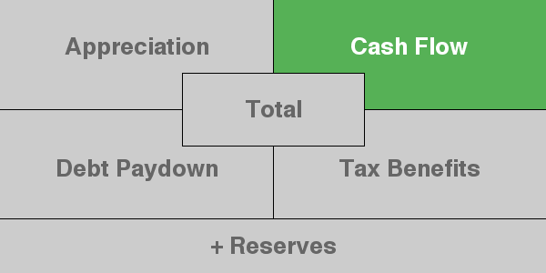
Capital Expenses Show Up in
Cash Flow

Slide 34
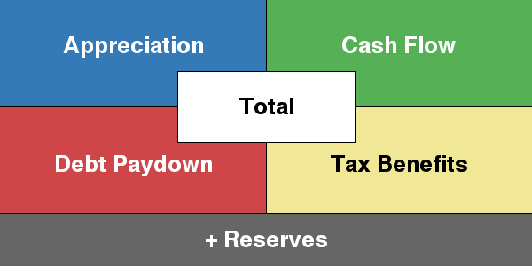
Cash Flow Isn’t Everything

Slide 35
Compare New Construction to Resale
New Construction
5-Year-Old Resale

Slide 36
Compare New Construction to Resale
New Construction
5-Year-Old Resale

Slide 37
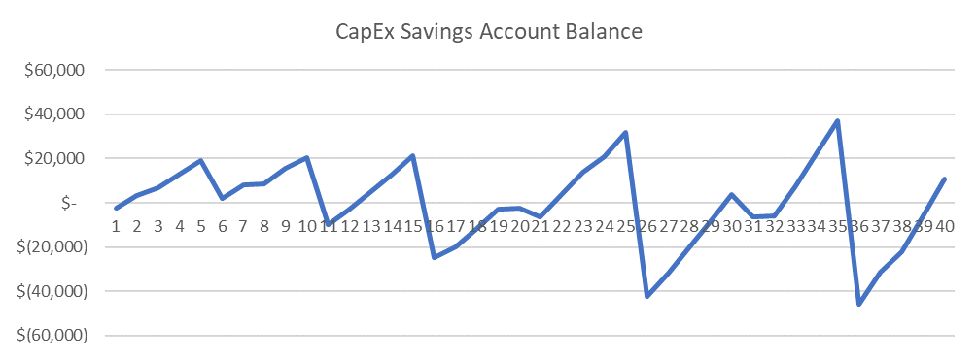
Compare New Construction to Resale
New Construction – No Deficit
5-Year-Old Resale - $38K Deficit Year 36
You’d need to save an additional $80 per month (that works out to be about $16,000 more in purchase price) to not have a deficit with a 5-year-old resale property.

Slide 38
As Home Price/Rent Declines, Maintenance and Capital Expenses Tends To Get Worse
Comparing less expensive and lower rent properties to higher priced and higher rent properties
  Same hourly rate for trades (and attorneys for evictions/disputes)
  Same court eviction costs
  Same cost for tax returns and accountants
  Same cost for asset protection
  Same cost of materials for many expenses
  But smaller rents
  Maintenance and Capital Expenses as a percentage of Gross Operating Income is MUCH higher as compared to higher priced and higher rent properties

Slide 39
Portfolio Planning
Types of properties you want in your portfolio
Older properties with high expenses
More less expensive properties or fewer more expensive properties
  Loan spots
  Tax returns
  Asset protection
  Same/similar dollar amount in maintenance and CapEx but very different percentages of Gross Operating Income
See entire class on buying criteria:
https://refp.com/establishing-your-buying-criteria-workshop/

Slide 40
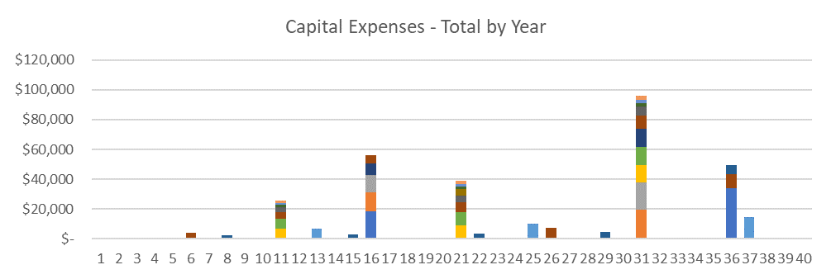
Can you “time” maintenance and capital expenses?
Sell at the red arrows before major expenses?
Or, buy after major expenses?

Slide 41
Selling Before Major Expenses
Model it
Compare your “Costs of Sale” to the “Expenses”
  Could sell it traditionally FSBO or with a real estate broker
    May or may not have some vacancy
    Hot markets are easier to sell with upcoming/deferred maintenance; softer markets it is much harder to sell with upcoming/deferred maintenance.
  Could sell it to a tenant-buyer (to save on real estate commissions and some closing costs)
  Could do a 1031 Exchange to defer capital gains and depreciation recapture
Can also help Return on Equity if you re-leverage up

Slide 42
Buying After Major Expenses
Buying the property that just got a new roof, kitchen remodel and AC
The smaller the size of the expense and the lower the frequency the less it matters
  Some expenses are large-in-size but low in frequency (like a $12K roof every 20 years)
  Some expenses are small-in-size by high in frequency (like $2,000 in landscaping every 7 years)
  Some expenses are medium-in-size and medium-in-frequency (like a $5,000 exterior paint every 10 years)
  Normalize by looking at the cost per year like in the BASIC spreadsheet (take into account inflation too)
You need to run your own numbers with each property, but for example… new roof versus 10 year old roof…

Slide 43
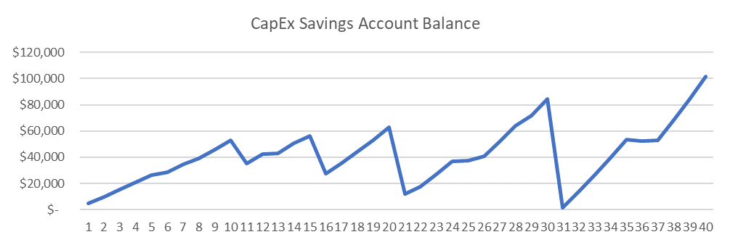
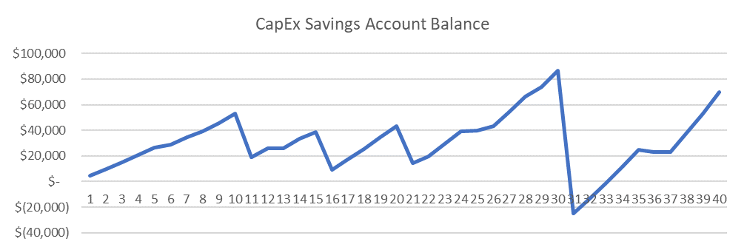
$25K Deficit in Year 31
New Roof At Purchase
10-Year-Old Roof At Purchase

Slide 44
Alternative To Saving Expenses
Use your own cash flow from this and/or other properties
  If enough exists to take the spending shock
Borrow the money for expenses instead of saving for them
You could “borrow” from yourself (like from your own reserves) and pay that back over time
  This reduces the reserves you have for your properties
You could borrow from a bank, a HELOC, a credit card, cash out refinance of this or another property
  Paying a premium in the form of interest instead of earning a return on money you’re saving
Increases risk by reducing reserves and/or having debt with interest

Slide 45
Insurance Claims
Not every time, but sometimes you get lucky and a roof that is partially through its lifespan will qualify for an insurance claim
  A common one here in Northern Colorado is a hail claim
Then, you can rerun your spreadsheet with your current expense savings balance and the current age, lifespan and cost of all your expenses to see if that changes how much monthly you should be setting aside
Same can apply to other expense items as well

Slide 46
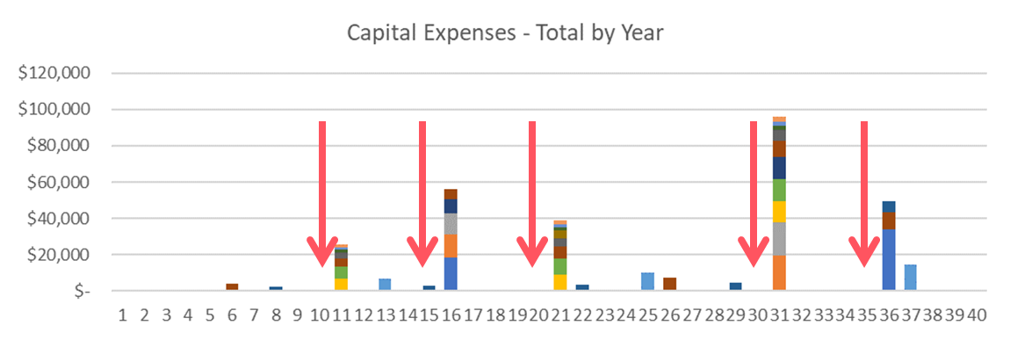
Home Warranty
If you have a home warranty company that will allow you to buy a policy at any time, you could choose to buy a policy as you approach your larger “home warranty” covered expenses
  Only covers some expenses
For example, if you’re lucky enough to have your AC last beyond its life expectancy you could buy a home warranty that covers your AC knowing that you’re very likely to have an expense to replace your AC in the next few years

Slide 47
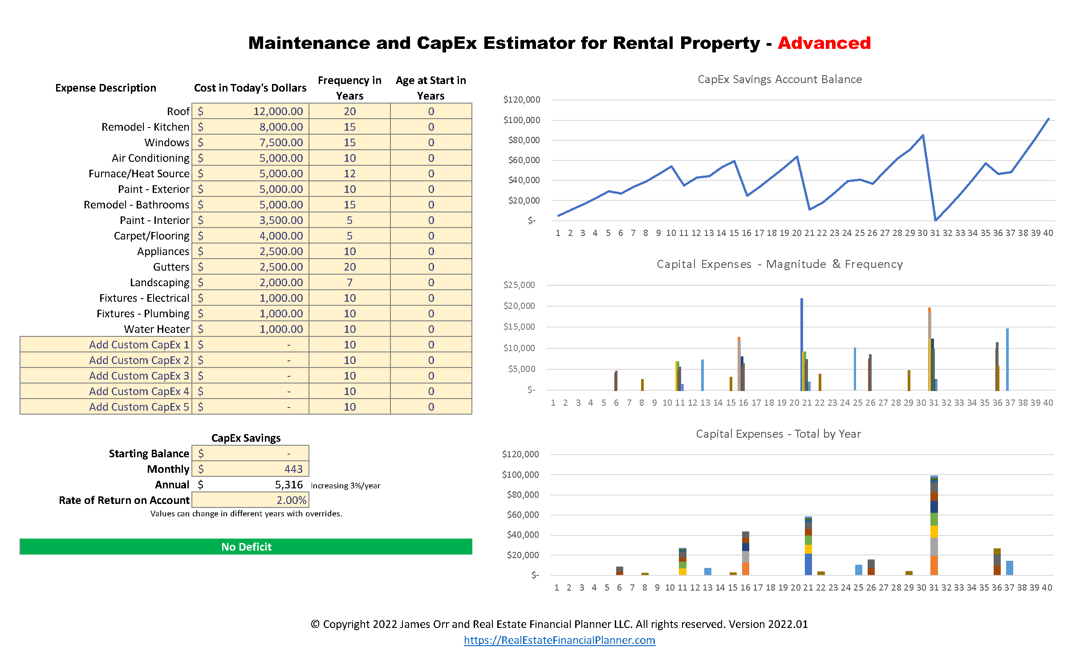

Slide 48

Welcome to Freaky Town

Slide 49
Starting Amount in CapEx Savings Account
Can’t I reduce the amount I need to save monthly for maintenance and CapEx if I start with money in the “CapEx Savings Account”?
Yes, but it doesn’t move as much as you’d think
Here are two charts showing what I mean…

Slide 50
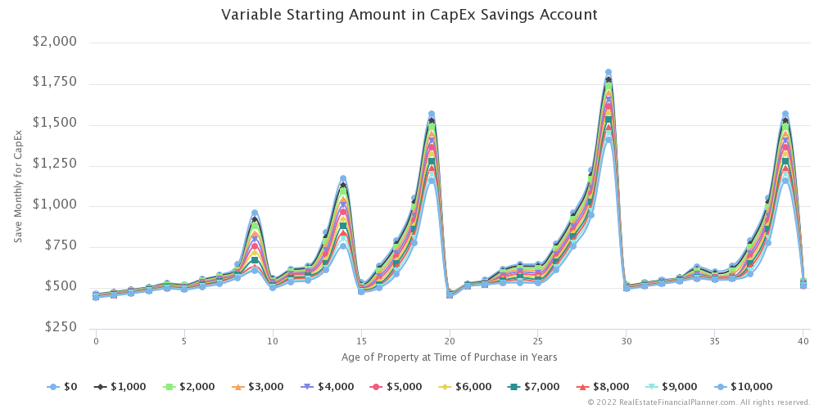

Slide 51
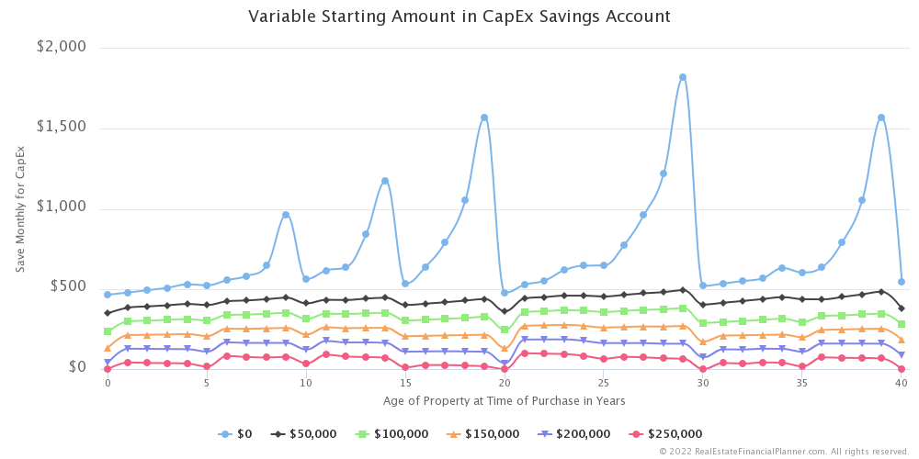

Slide 52
How Does This Impact Cash on Cash ROI
We’re varying “Starting Balance” for CapEx Savings Account (“Rent Ready Cost”) and then solving for “Monthly/Annual Maintenance and CapEx”
The “Starting Balance” gets added to “Rent Ready Costs”
The “Monthly/Annual Maintenance and CapEx” is an expense when calculating cash flow
Cash on Cash ROI is affected by both since we’re dividing Cash Flow by “Total Invested” (including “Rent Ready Costs”)
Let’s look at how Cash on Cash ROI the first year is impacted if we have $0 starting balance and buy a new construction property through to a 40-year-old property that had regular maintenance…
  Assumes you had break-even cash flow in year 1 with 25% down for a new construction property

Slide 53
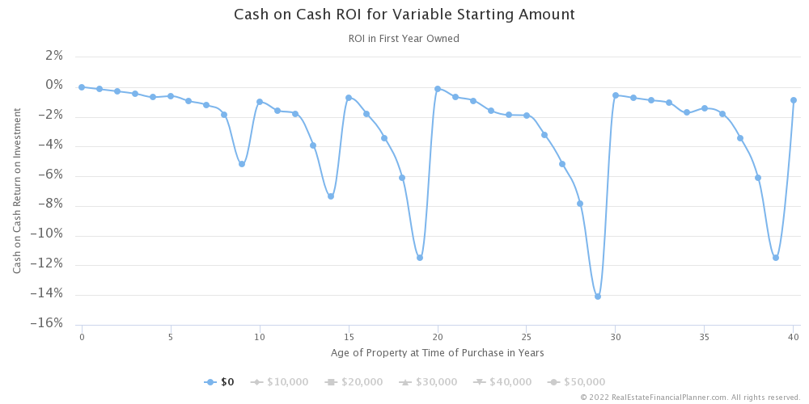

Slide 54
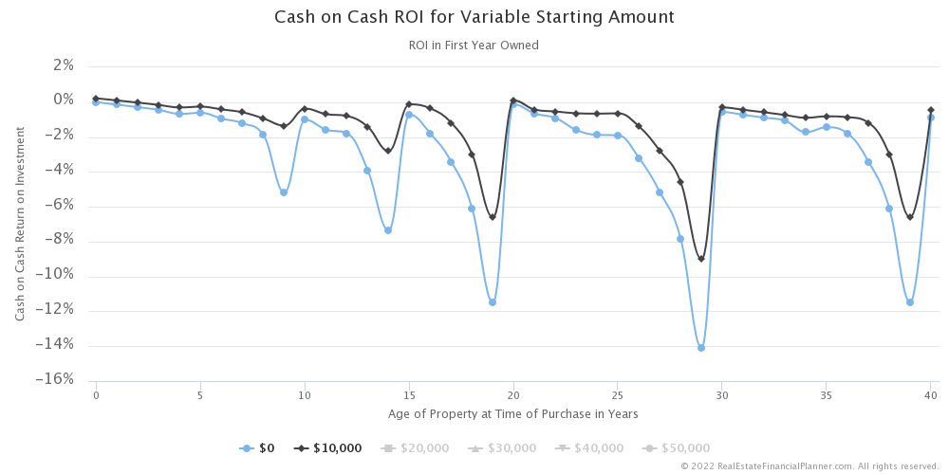

Slide 55
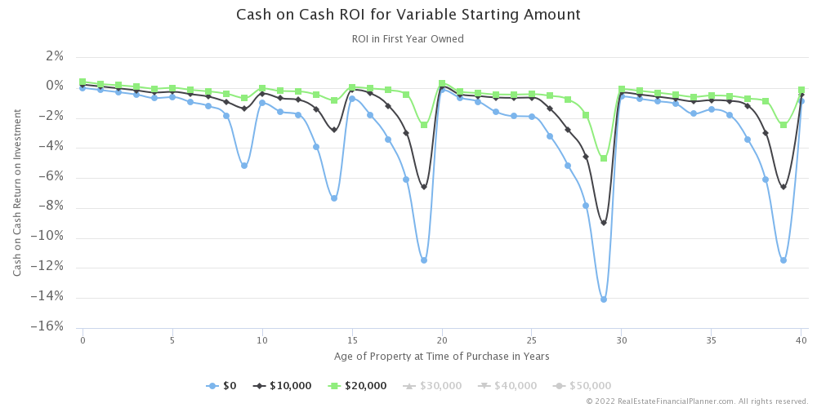

Slide 56
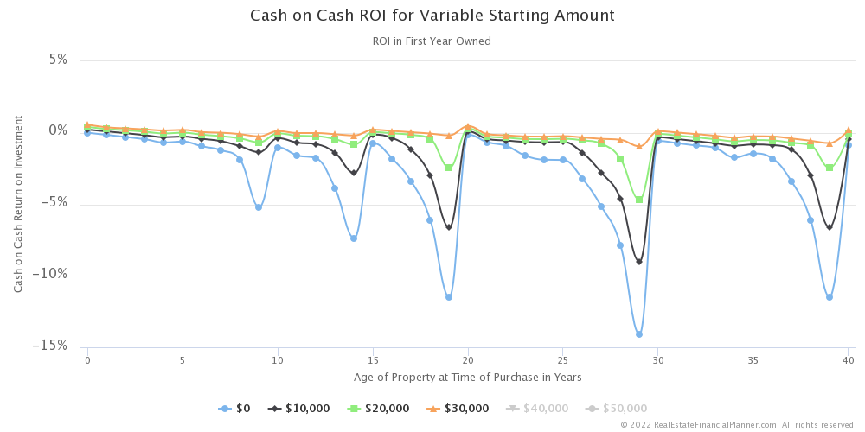

Slide 57
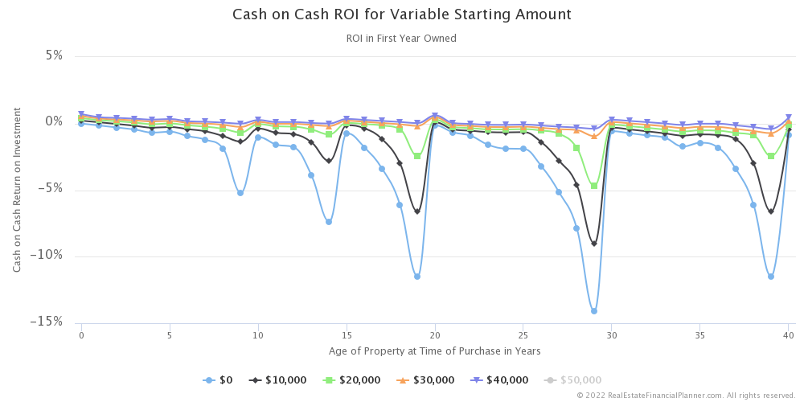

Slide 58
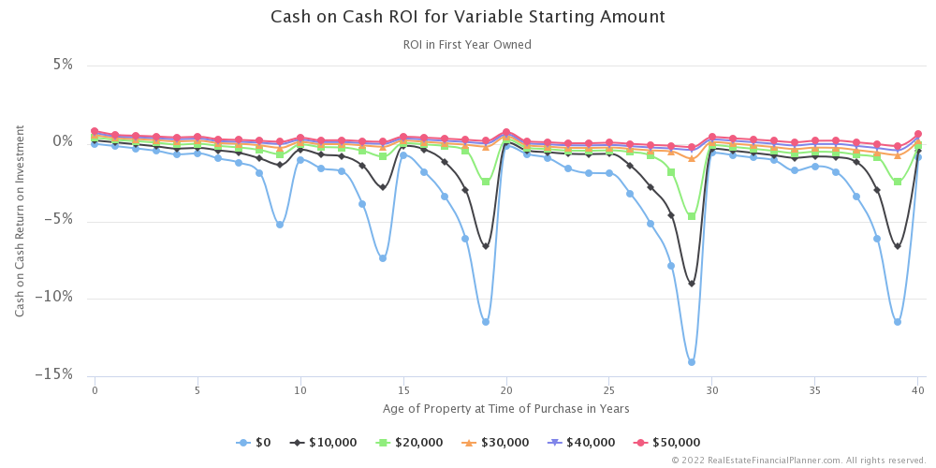

Slide 59
CapEx Impact on Cash on Cash ROI
Setting aside money as a “Starting Balance”/“Rent Ready Costs” does slightly improve cash flow and improves Cash on Cash ROI
However, it lowers the Return on Investment (ROI) from Appreciation, Debt Paydown, Tax Benefits and Reserves too.

Slide 60
Tips and Recommendations
Just created these two new spreadsheets and did some analysis on the impact to Cash on Cash ROI for the first time (mere days before this presentation)
Not sure I have good “rules of thumb” or confidence in generalizing the results… yet
However, here are my best guesses for some tips and recommendations:
  In general, it is better to buy a new construction property where all your maintenance and capital expenses are at the very beginning of their cycles
    We can calculate what premium you can afford to pay for new construction by looking at the difference in required monthly CapEx payments for each
  Watch out when buying properties that have upcoming repairs!
  CapEx can be one of the most significant expenses
    For most folks, it is far bigger than they thought it might be (partially because of inflation)
  Magnitude of the repair cost and frequency both matter
    Look at the annual/monthly amount by dividing the inflated cost by the replacement period to get a feel for which maintenance and capital expenses are most significant
  It is better for Cash Flow to front-load money into the CapEx Savings Account, but that’s short-sighted and it is better overall to pay for CapEx from cash flow

Slide 61

jamesorr@gmail.com
https://RealEstateFinancialPlanner.com
James Orr

